Slide 1
Variations in Political Legitimacy Across Time and Space
Cultural and Customary Traditions
That Inform Differing Traditions

Slide 2
Different Regimes Define Borders to Affirm Political Legitimacy
Empires vs. Nation States -
Keep Them In or Keep Them Out?

Slide 3
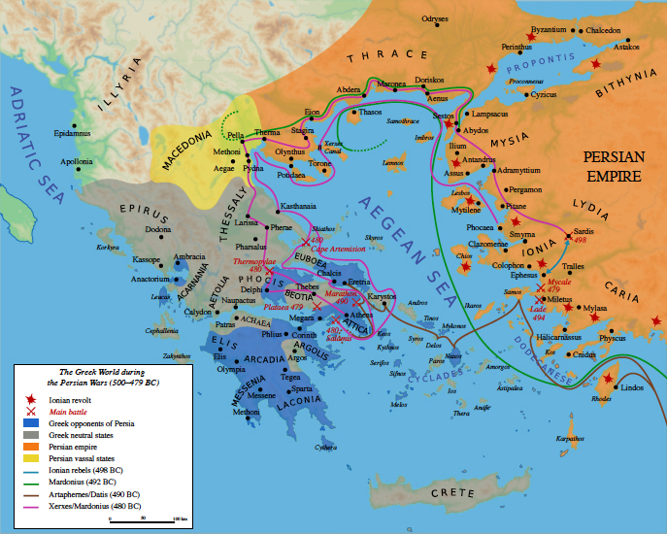
The Greco-Persian wars of the Fifth Century BCE defined the contest for political legitimacy between city/nation-states and empire. Greek victories at Marathon (490 BCE) and Salamis (480 BCE) avoided a Persian imperial model in Europe but this proved ephemeral following the Peloponnesian War (430-404 BCE). Democratic governance would again prove ephemeral during the transition of Rome from Republic to empire

Slide 4
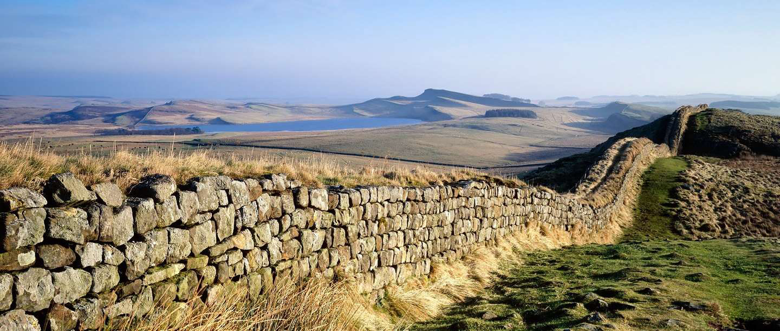
Roman emperor Hadrian built a defensive wall in 122 CE to defend the borders against the Picts. Roman emperor Antonine built another wall farther north near the Firth of Forth in 142 CE with the same objective. Elsewhere, Romans built few military walls and relied on occupation of conquered territories to impose Roman law and taxation. Walls would matter less than the opportunity for citizenship and commercial exchange over time, leaving open the question of whether military occupation was a key to economic prosperity.

Slide 5
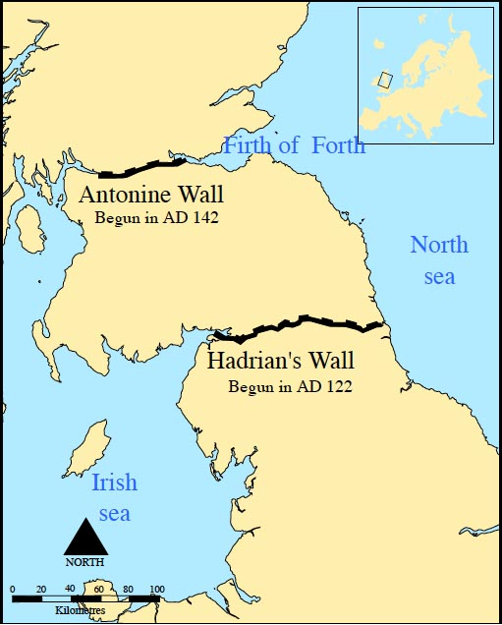
Imperial borders have a tendency to expand the frontiers of occupation and governance

Slide 6
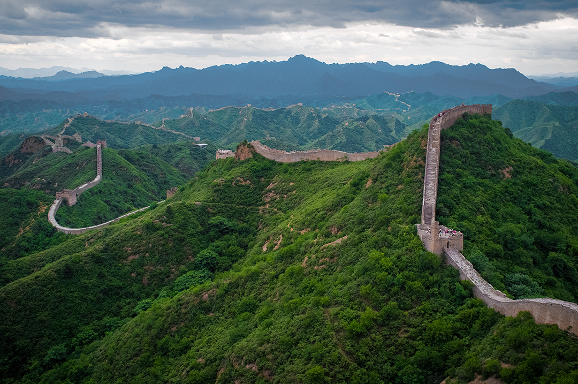
Built over several centuries (from ca. 215 BCE and ending in 1644 CE) the Great Wall of China served as a defensive line against invasion from the Mongols. It not prevent the Mongols from invading and ruling China. Mongol rule of China began under Genghis Khan (1162-1227), and ended in 1368 when the Ming overthrew the Yuan dynasty. With a length of 21,196 km (13,171 miles),the Great Wall is one of the few monuments on earth visible from outer space. As with other walls, the Great Wall illustrates the limitations of border walls as a means of asserting collective identity and political legitimacy.

Slide 7
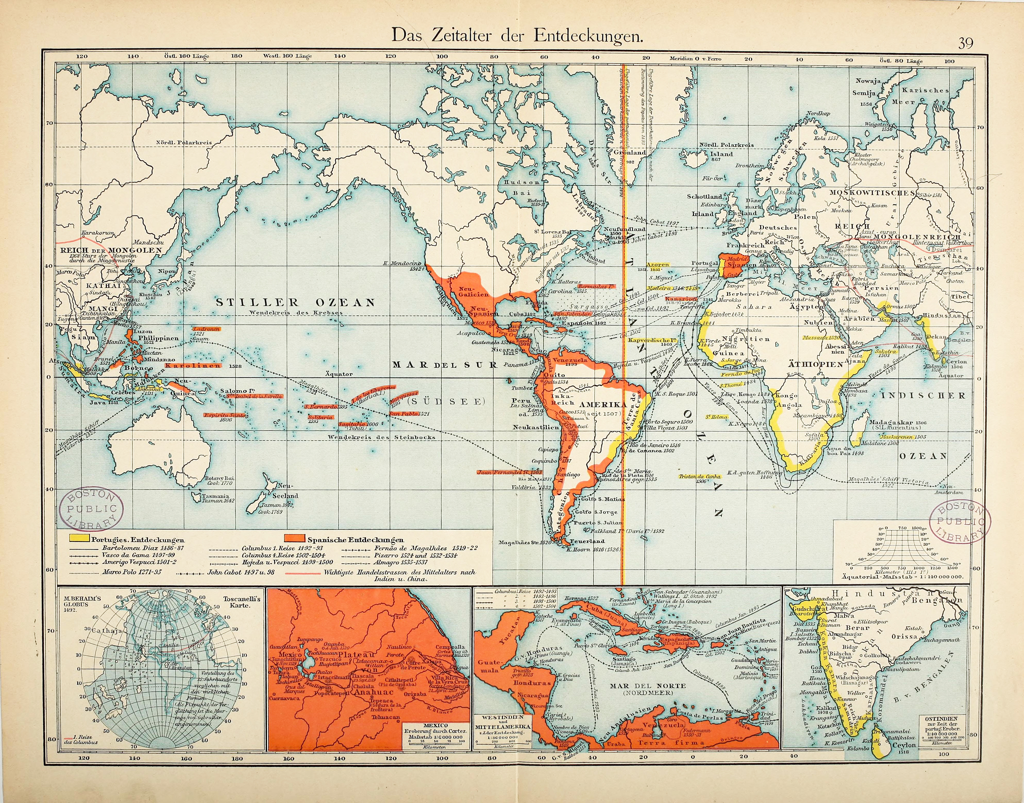
While the ancient Greeks put forth a model of democratic governance, it would take centuries for it to assume a model of political legitimacy. Instead, in Europe, as in Asia, empire emerged out of the Renaissance to define governance over many parts of the globe. The Portuguese and Spanish were pioneers in imperial expansion, following the voyages of Christopher Columbus (1452-1506) that began in 1492.

Slide 8
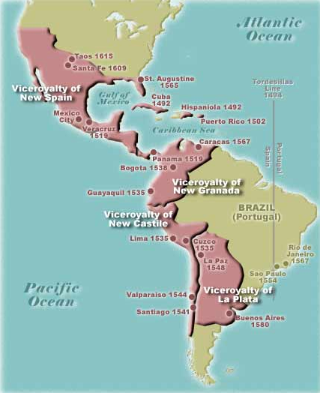
The Treaty of Tordesillas crafted on June 7, 1494 and orchestrated by Catholic Pope Alexander VI (1431-1503), and signed by Spain on July 2, 1491 and by Portugal on September 5, 1491, assigned North American territories to the east of 370 Meridian leagues to Portugal and the remainder west to Spain. Spain justified the conquest of Aztec, Inca, and other Native American populations as fulfilling a Christian mission. This “civilizing mission” served as the basis for political legitimacy, even as the underlying motives for conquest lay more in access to natural resources.

Slide 9
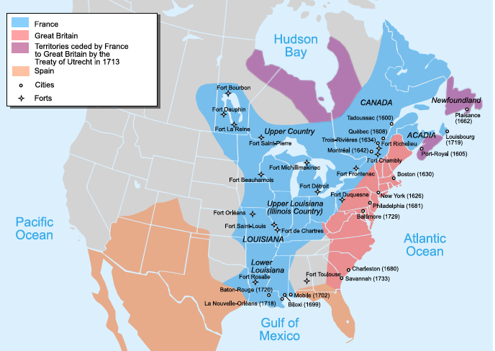
Excluded from the Treaty of Tordesillas, French, English, and Dutch rulers and merchants were eager to compete for control of territory and trade in the Americas. The first French North American empire began with the 1535 expedition of Jacques Cartier along the St. Lawrence river in Quebec, while the English focused on the lower Atlantic colonies, beginning with the failed Roanoke colony in 1585, and followed by the Jamestown settlement in 1607. Dutch traders soon established themselves in the Hudson Valley and down to the Delaware coast. In all of this, all competed against the Spanish for trade in the Caribbean, and would soon expand their imperial domains based on the trans-Atlantic slave trade. With some 12,000,000 slaves imported from Africa, political legitimacy did not extend to the rights of all residents, not unlike the notion of citizenship in the Greek and Roman systems where slavery was taken as the natural order of governance.

Slide 10
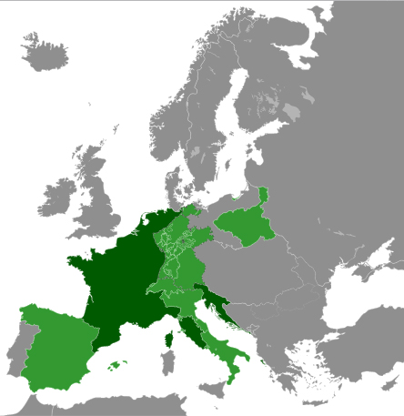
The European Enlightenment of the eighteenth century coincided with imperial expansion elsewhere. As European empires expanded, the notion of natural law as a basis for political legitimacy gave rise to revolutionary sentiments that would change the map of Europe, as well as North America. Napoleon Bonaparte (1769-1821), who rose to power by military means first built a European empire based on the expansion of the achievements of the French Revolution, but was defeated by a coalition of powers determined to restore traditional monarchy in Europe.

Slide 11
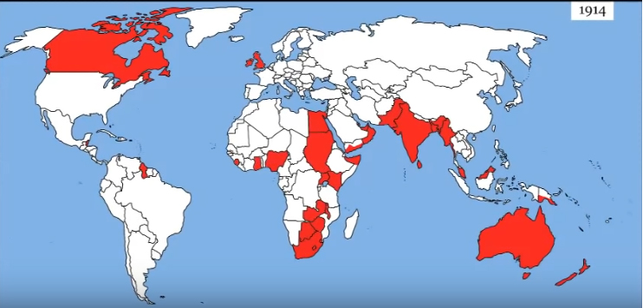
The French empires of North America, and later Africa and East Asia, extended over a larger area than that of the British, though with fewer populations under its control. Under Queen Victoria (1818-1901), the British empire by 1913 controlled 412 million people, 23 percent of the world’s population at the time and 24 percent of the earth’s total land area. Queen Victoria had less political power than Charles I (1600-1649), due in part to the Glorious Revolution of 1688 that was inspired by John Locke (1632-1704), whose Second Treatise on Government built on the Magna Carta of 1215 to assert that natural rights precede any notion of governance, setting the stage for the transition of England to a constitutional monarchy. Following the overthrow of Napoleon at Waterloo in 1815, France vacillated between a Republican form of government and monarchy, with the former winning out with the defeat of Napoleon III in the Franco-Prussian war of 1870-71. Devolution of authority would increasingly define political legitimacy, though colonial rule would still prevail as a standard of governance until the end of World War II.

Slide 12
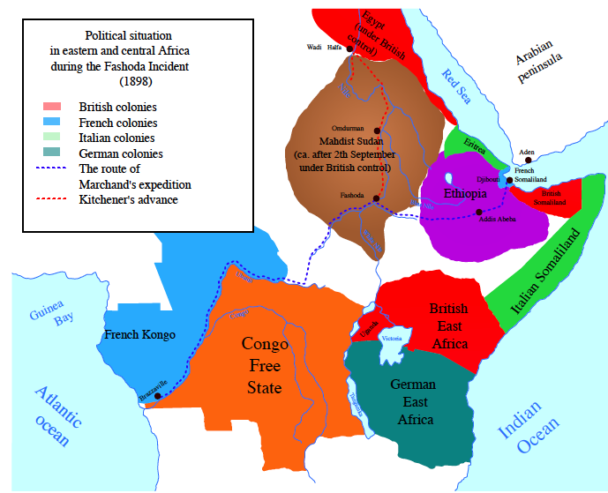
The contradictions of colonial rule were first raised by the American War of Independence (1776-1783), and again in the imperial Scramble for Africa that was orchestrated by German Chancellor Bismarck at the Berlin conference of 1885. At Fashoda, Sudan, in 1898, British and French armies came close to engaging in a colonial war for the axis of control – north to south or west to east. Out of this, Ethiopia managed to hand a resounding defeat to imperial latecomer Italy in the Battle of Adwa in 1896. Except for the Italian occupation of 1936-1941, Ethiopia has remained as the longest independent country in Africa, even as its own system of governance has undergone revolution from imperial rule to the current Democratic Republic.

Slide 13
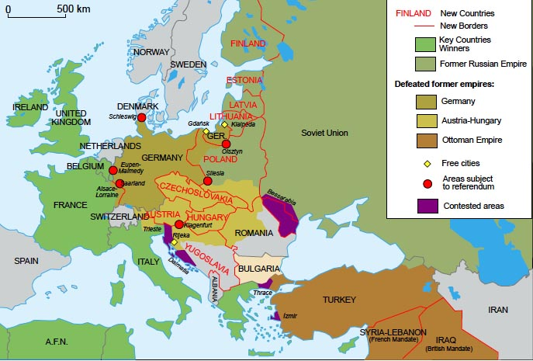
The end of World War I brought the collapse of European empires in Austria and Russia, even as France, England, Spain, and Portugal continued to administer their colonial possessions. Woodrow Wilson’s (1856-1924) Fourteen Points at the Versailles 1919 Peace Conference served as the basis for national self-determination, and in which nation-states, in the spirit of the Congress of Vienna in 1815, would decide their boundaries based on some mix of royal tradition or democratic principles. The latter was most embedded in the United States and France, followed by the German Weimar Republic and the Republic of Italy. Revolutionary Soviet Russia took the path of political absolutism under Vladimir Lenin (1870-1924) and Joseph Stalin (1875-1953) in the guise of a Union of Soviet Socialist Republics, a model that would later be emulated by China under Mao Tse Tung (1893-1976).

Slide 14
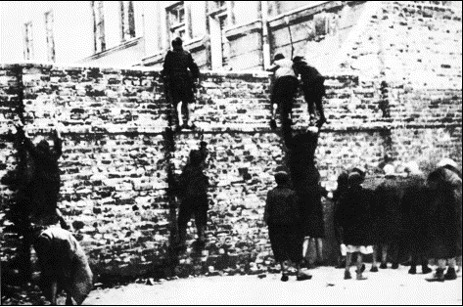
With the collapse of the Weimar Republic in 1931, Adolf Hitler (1879-1945) went on to establish a Nazi dictatorship based on racial purity that involved the extermination of religious and ethnic minorities in its midst. With the fall of Poland in 1939, the Nazis established the Warsaw Ghetto wall on April 1, 1940. Although Jewish residents engaged in an uprising on April 19, 1943, persecution and extermination prevailed until the Nazis were finally defeated on May 7, 1945. The Warsaw Ghetto wall was an effort to keep a population within, in contrast to the Hadrian and Great Wall of China, where the goal was to keep a population out.

Slide 15
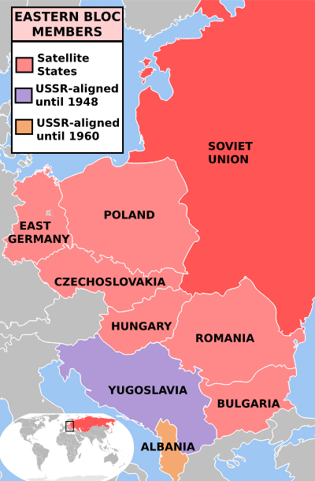
World War II ended with allied and Soviet armies occupying vast territories. In the West, allied armies soon restored prewar boundaries while in the East, Joseph Stalin (1879-1953) chose to increase Soviet security through the creation of a buffer zone that evolved into the Warsaw Pact of countries, and which was countered by the Western Europe North American Treaty Organization, or NATO, in 1949. Under Josef Broz Tito (1892-1980), Yugoslavia broke away in 1948, but Soviet governance of Eastern Europe would prevail until the collapse of the Soviet Union in 1991.

Slide 16
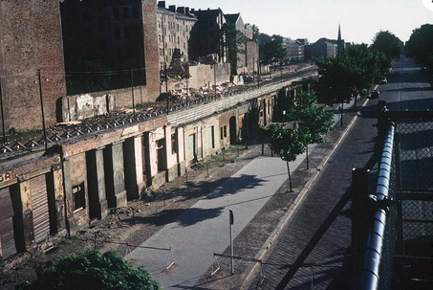
Emblematic of the Soviet empire, Stalin first sought to oust allied governance of Berlin in 1948, then sought to solidify control through the construction of the Berlin Wall, beginning in 1961, at the height of the Cold War in Europe. The Berlin Wall could not prevent some in the East from escaping to the West, and when internal contradictions in Soviet governance proved unsolvable, the USSR formally dissolved itself on December 26, 1991. Since then, the Russian Federation has struggled with the notion of political legitimacy by a combination of restoration of the Russian Orthodox Church and imperial expansion in an effort to re-establish control over area once under its authority. Under Vladimir Putin, Russian forces moved to occupy Crimea, once a Soviet naval port, in March, 2014, a move contested by the UN and the international community but which has not resulted in a return to Ukrainian authority from which it had been taken.

Slide 17
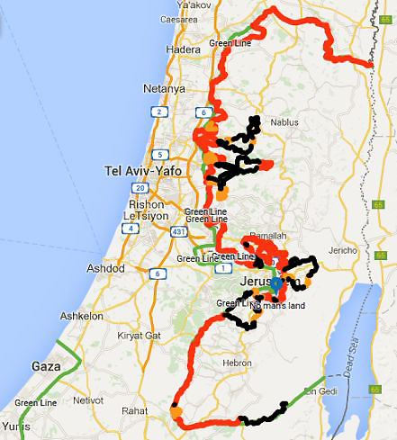
Elsewhere, political legitimacy has been fought over through the erection of walls, one example of which is the Israel security barrier. Begun in 2005 not long after Israel withdrew its occupation of Gaza, Israeli occupation of the West Bank since the 1967 war has posed logistical and identity challenges for both Israelis and West Bank Palestinians. The Security Wall serves two purposes: 1. the reinforce the legitimacy of Israeli settlements in the West Bank; 2. the prevention of terrorist attacks on both the settlements and within Israel proper. Ever since the founding of the State of Israel in 1948, several wars have been fought over borders, and thus the political legitimacy of Israel and the Palestinians. The security wall has significantly reduced terrorist attacks, but the presence of a Palestinian population under Israeli jurisdiction raises questions of what constitutes the national identity. The Palestinian Authority that rules in the West Bank and Hamas that rules in Gaza further complicates the question of Israeli-Palestinian border political legitimacy, and which show no signs of a solution at the present time. Israeli Prime Minister Benjamin Netanyahu’s decision to name a Golan Heights settlement after Donald Trump only confounds the path to a solution with Syria, who lost the Heights in the 1967 war.

Slide 18
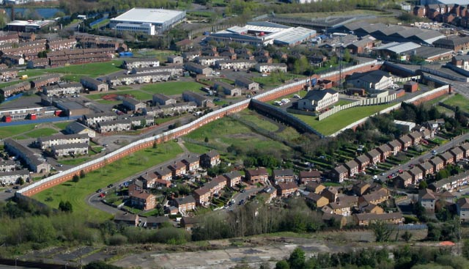
Ever since the Easter Uprising of 1916, Ireland has been governed in a divided fashion. The Republic of Ireland, largely under Catholic rule, controls the majority of the island, while Protestants prevail in the North. The wall that separates Catholic and Protestant Belfast symbolizes the legacy of sectarian violence in determining political legitimacy, with both England and Ireland now committed to a peace process that may yet result in political unification of the north with the south.

Slide 19
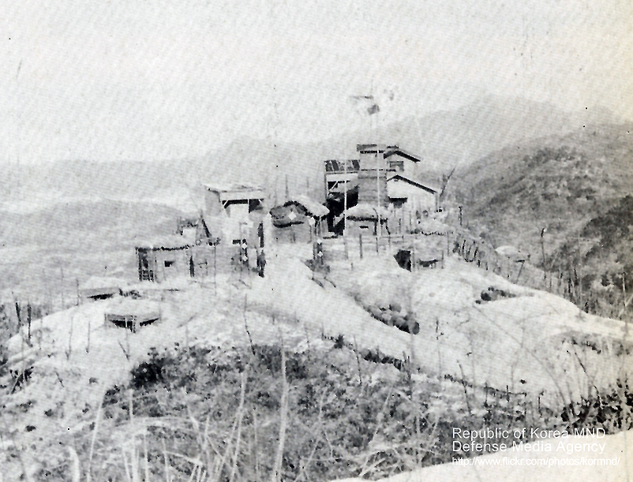
Elsewhere, walls continue to define political boundaries. One of the most notable is the DMZ that divides North and South Korea. Following the Peninsular war of 1950-1953, the North has remained a dictatorship now under Kim Jong-Un (1983- ) while the South has emerged as a Republic under President Moon Jae-in (1953 - ). Although Donald Trump has sought to achieve an agreement for a non-nuclear Korean peninsula, thus far all that has been accomplished is recognition of North Korean sovereignty by the U.S., putting a nominal end to hostilities that date to 1953. As with the Berlin Wall, the DMZ serves as a symbol of divided notions of political legitimacy in North and South Korea.

Slide 20
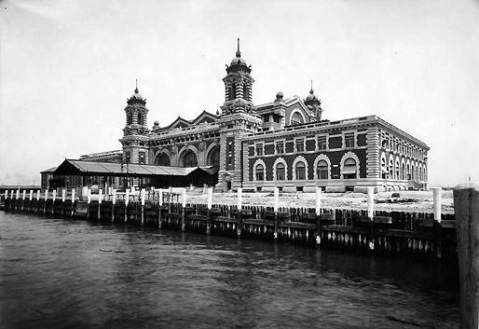
Border control in the U.S. has historically been through designated points of entry. Ellis Island, near the Statue of Liberty in New York harbor, served as a principal port of entry for immigrants arriving largely from Europe in the latter nineteenth and early twentieth centuries. With ships of immigrants having to pass border controls on Ellis Island, inflows were largely regulated.

Slide 21
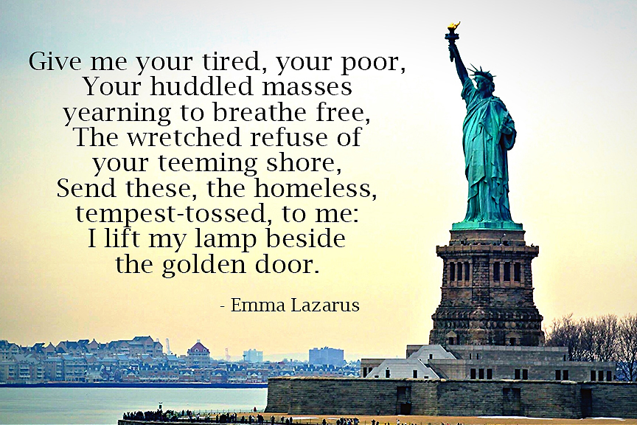
At the Statue of Liberty, a gift from French citizens and dedicated on October 28, 1886, a poem by Emma Lazarus evokes the value of immigrants to the American dream as the land of opportunity. It is a value under strain in the presence of uncontrolled immigration now largely confined to the U.S. southern border with Mexico. By efforts to build a physical wall along the border, Donald Trump calls into question the definition of American as a haven for immigrants fleeing persecution and economic hardship abroad, and for which border security is now a protracted debate thus far still unresolved.

Slide 22
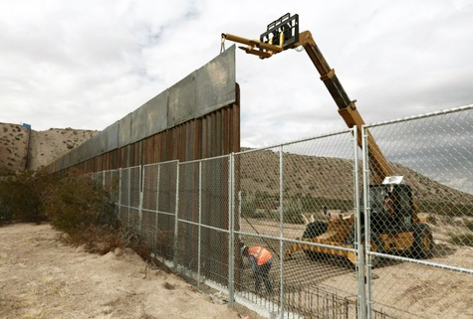
Portions of the U.S.-Mexico border wall now under construction and the subject of debate in the U.S. Congress

Slide 23
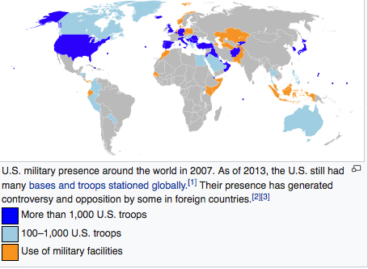
The U.S. as global policeman, or military agency of a global empire. Most Americans do not see the U.S. as a global empire, even though commentators across the U.S. and foreign spectrum have used this term. However construed, U.S. military power abroad serves as a kind of border control, as evidenced by the U.S. invasion of Iraq in 2003, and continuing conflicts in Afghanistan and elsewhere through the globe. U.S. military forces are concentrated in Europe, but training of local forces and military weapons sales serve as means to establish and preserve U.S. military superiority through bilateral and multilateral agreements. This global role has been evident most significantly since the end of the Second World War, though now under rising financial strain as the U.S. leads but faced economic challenges from rising powers such as the People’s Republic of China. China’s current leader, Xi Jingpin (1953 - ), who on March 11, 2018, no longer has a two-term limit on the presidency, and can remain as “President for Life”, a return to the older Mandarin tradition of governance. An echo of this can be seen in Vladimir Putin (1952 - ). Declared on July 6, 2019 that “liberalism is obsolete”, meaning that electoral traditions in Western Europe and North America do not provide answers to 21st century problems of political legitimacy and governance.

Slide 24
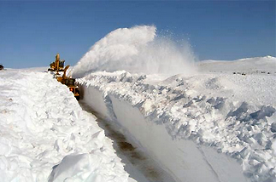
The Canadian Border
Canadians may have the answer to border walls as the basis for political legitimacy. Though borders do address to some extent the notion of individual and collective identity, questions of internal governance still provide ambiguous answers to the question of how should internal governance be decided. To answer this question, we need to take into consideration how domestic governance is shaped by social and natural science, from which economics may provide some guidance.

